Slide 1
preparing text data
preparing text data: use keras TextVectorization layer
you can only process numeric tensors
standardize
converting the text to lowercase or removing punctuation
tokenize
word-level tokenization. Starting → star + ing, called → call + ed
N-gram. N consecutive words. “the cat”, ”he was” would be 2-gram tokens
character-level: rarely used.
sequence models: those care about word order
bag-of-word models: doesn’t care about word order
index
convert each such token into a numerical vector

Slide 2
word embedding: map human language into a structured geometric space
from pet to wild animal
wolf
x
tiger
x
dog
x
cat
x
from canine to feline

Slide 3
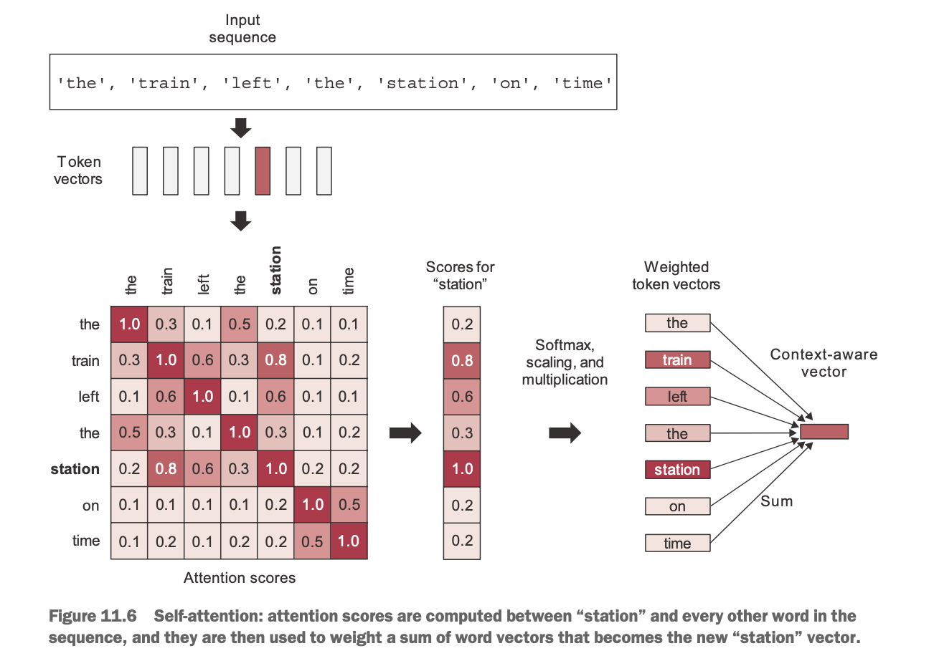
self attention
1. compute the relevance scores between the vector for “station” and every other word in the sentence.
clearly, a smart embedding space would provide a different vector representation for a word depending on the other words surrounding it.
vector for “stations”
vector for other words, for example “train”
attentions scores
relevance scores
=
=
dot
the resulting vector for “station”
word embedding
word embedding
pretrained embedding
2. compute the sum of all word vectors in the sentence, weighted by our relevance scores.
the resulting vector is our new representation for “station”: a representation that incorporates the surrounding context.

Slide 4
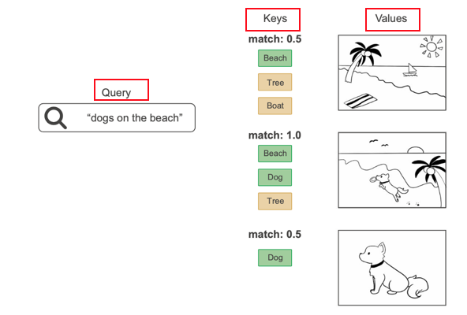
generalized self-attention: the query-key-value model
1
machine translation
a Transformer encoder to process the source sequence
input sequence:
how’s the weather today?
for each element in target (like “tiempo”)
go back to the source and identify the different bits that are related to it
tiempo and weather should have a strong match
source
keys + values
target
output sequence:
¿Qué tiempo hace hoy?
a Transformer decoder that uses the source sequence to generate a translated version
query
the Transformer architecture was originally developed for machine translation
a transformer is a sequence-to-sequence model
it was designed to convert one sequence into another.
1
text classification
keys & values & query are all the same

Slide 5
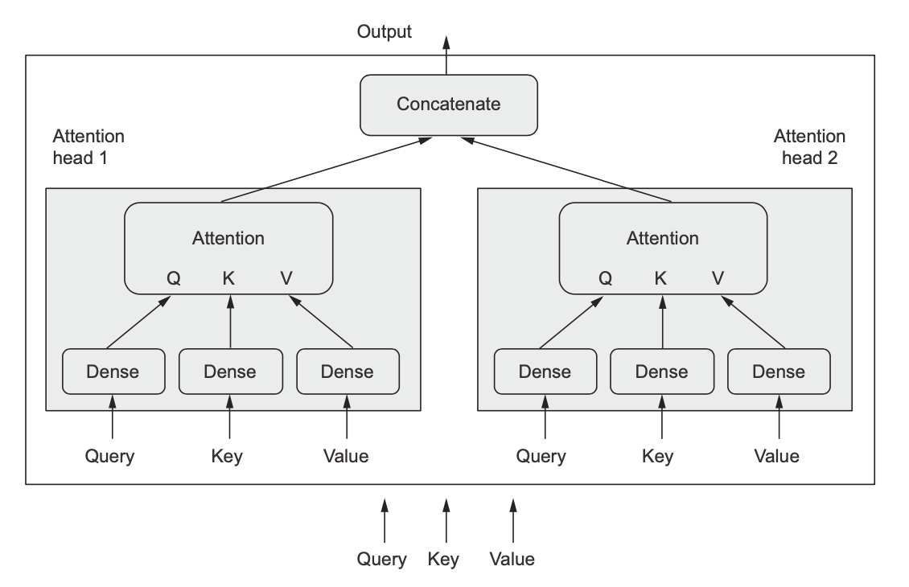
multi-head attention
neural attention

Slide 6
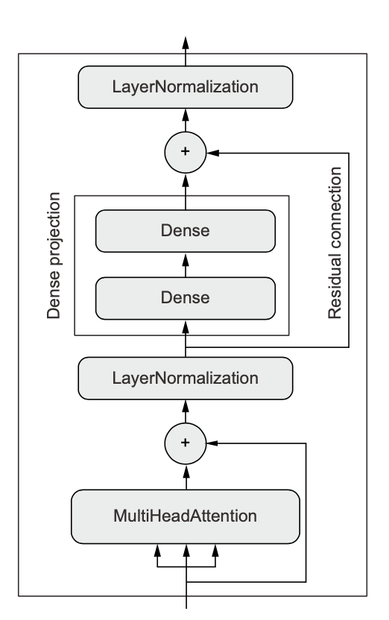
the transformer encoder
normalization layers are supposed to help gradients flow better during backpropagation
the MultiHeadAttention layer

Slide 7
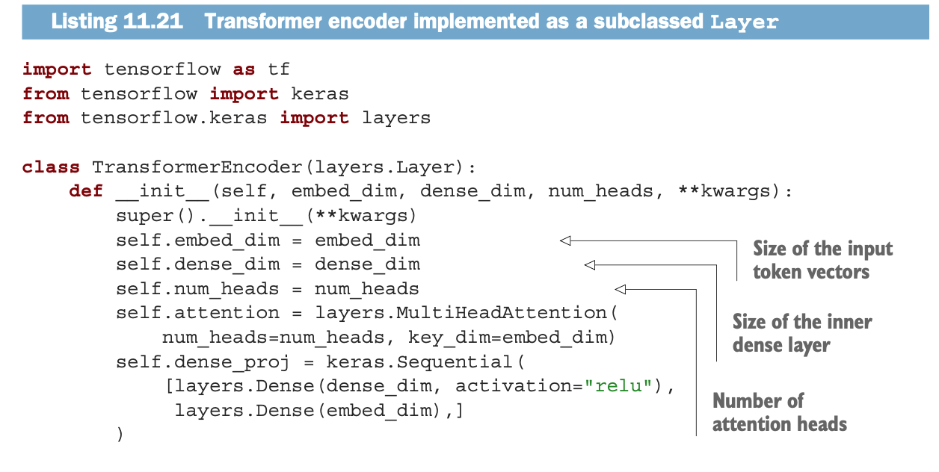
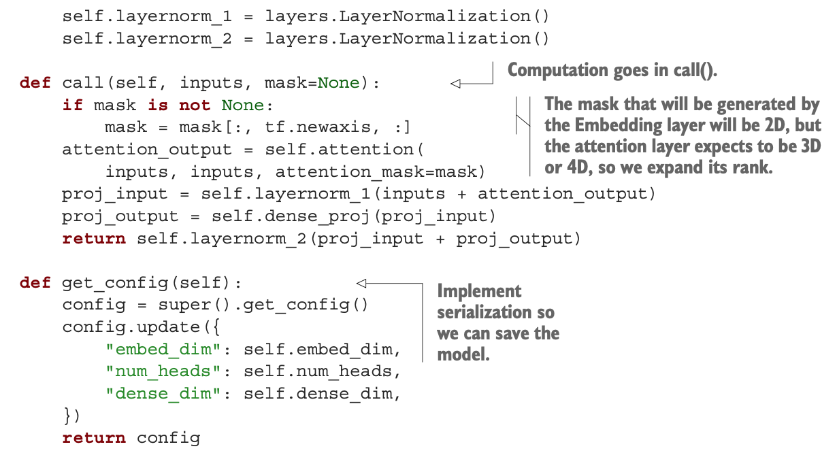
the transformer encoder implementation
MultiHeadAttention()

Slide 8
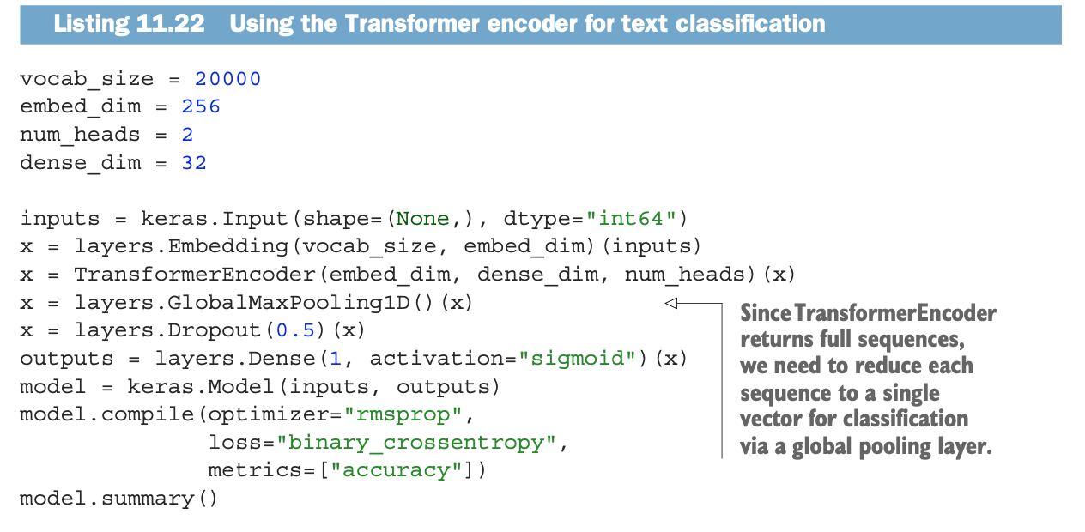
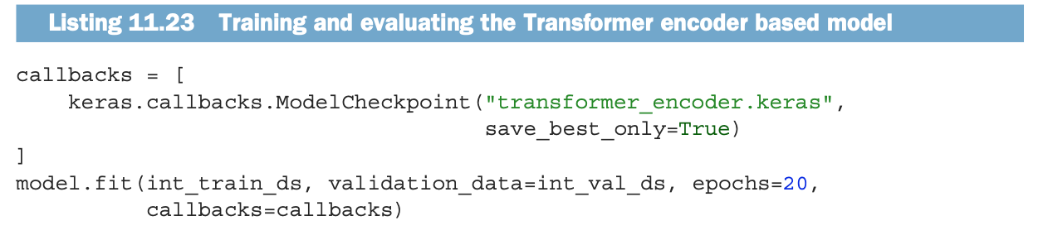
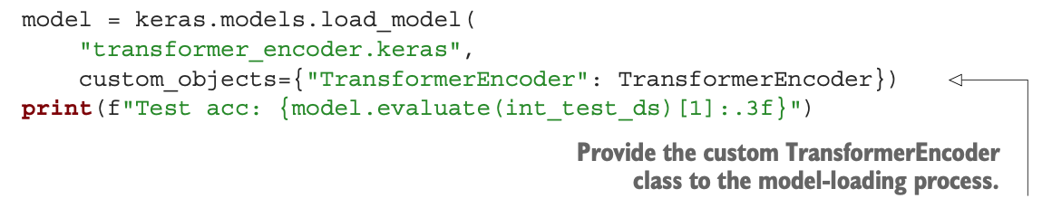
using the Transformer encoder for text classification
pretrain the input (we should use positional embedding to pre-inject word order information)
process input (pretrained) via transformer encoder
training

Slide 9
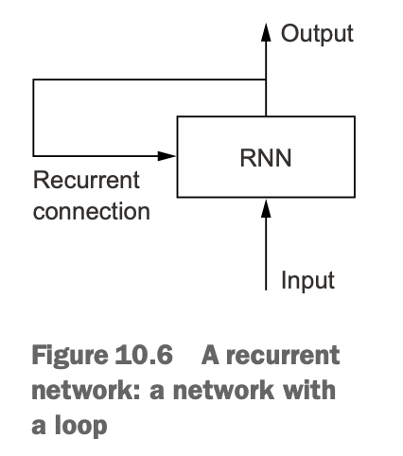
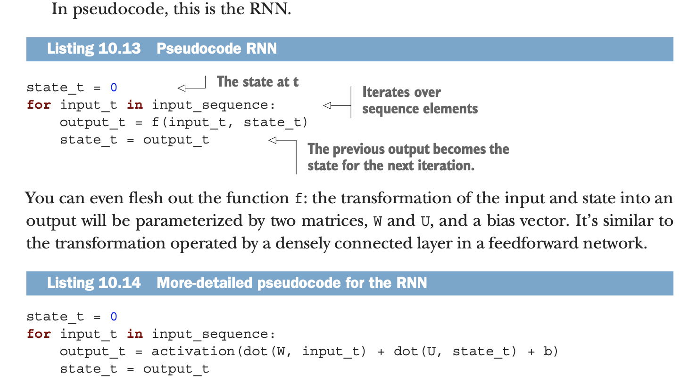
Appendix: RNN (recurrent neural network) - 1

Slide 10
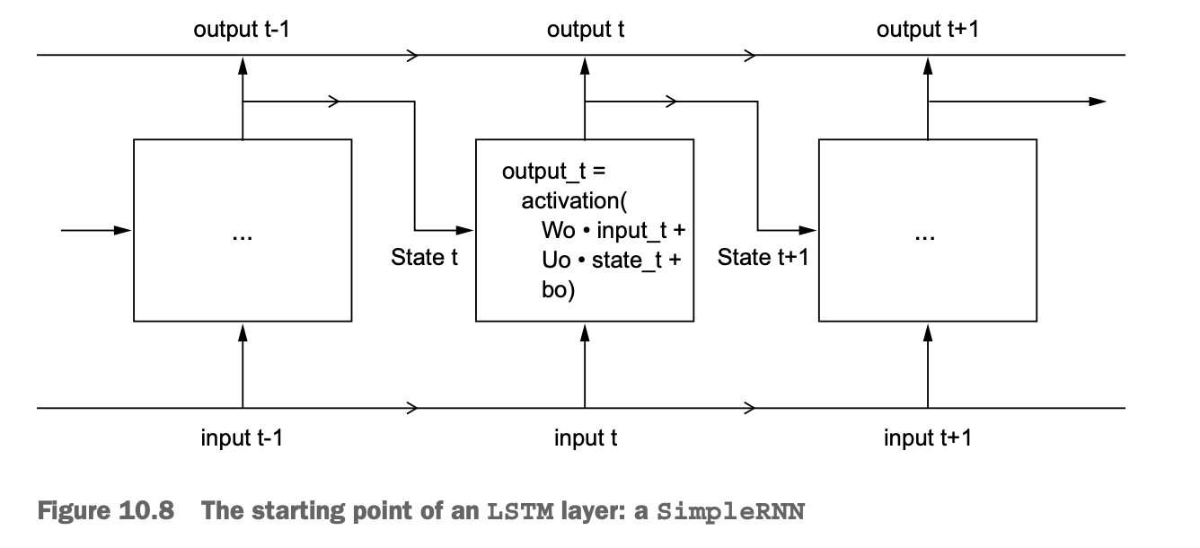
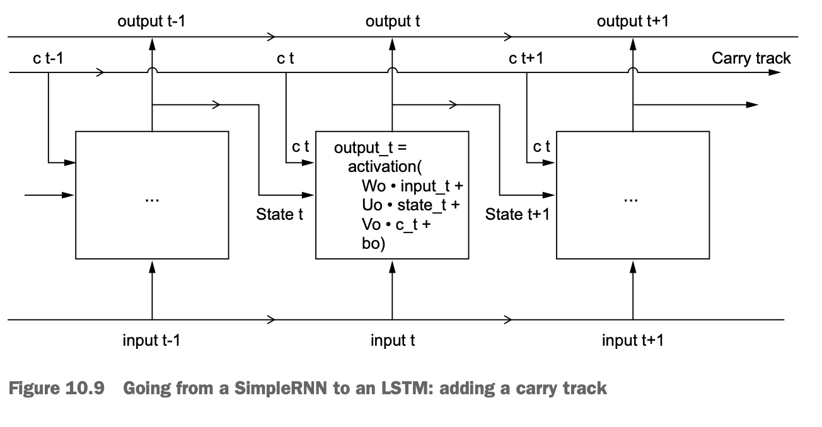
Appendix: RNN (recurrent neural network) – LSTM (long short-term memory)
This is essentially what LSTM does: it saves information for later, thus preventing older signals from gradually vanishing during processing.

Slide 11
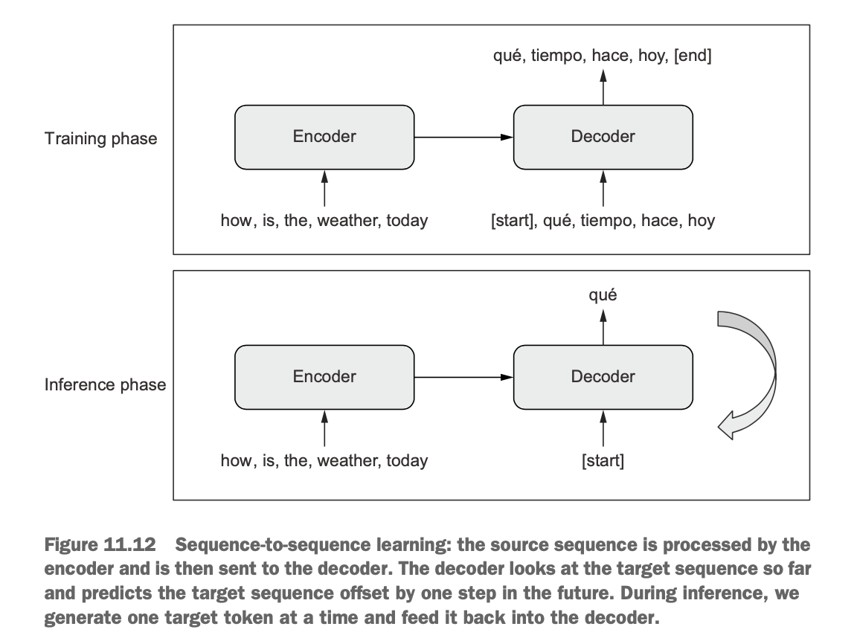
beyond text classification: sequence-to-sequence learning
during training
encoder: turns the source sequence into an intermediate representation
decoder: trained to predict the next token i in the target sequence by looking at previous tokens (0 to i-1) and the encoded source sequence.
during inference (have no access to the target sequence)
we obtain the encoded source sequence from the encoder
the decoder starts by looking at the encoded source sequence as well as an initial “seed” token (such as the string “[start]”), and uses them to predict the first real token in the sequence.
the predicted sequence so far is fed back into the decoder, which generates the next token, and so on, until it generates a stop token (such as the string “[end]”)

Slide 12
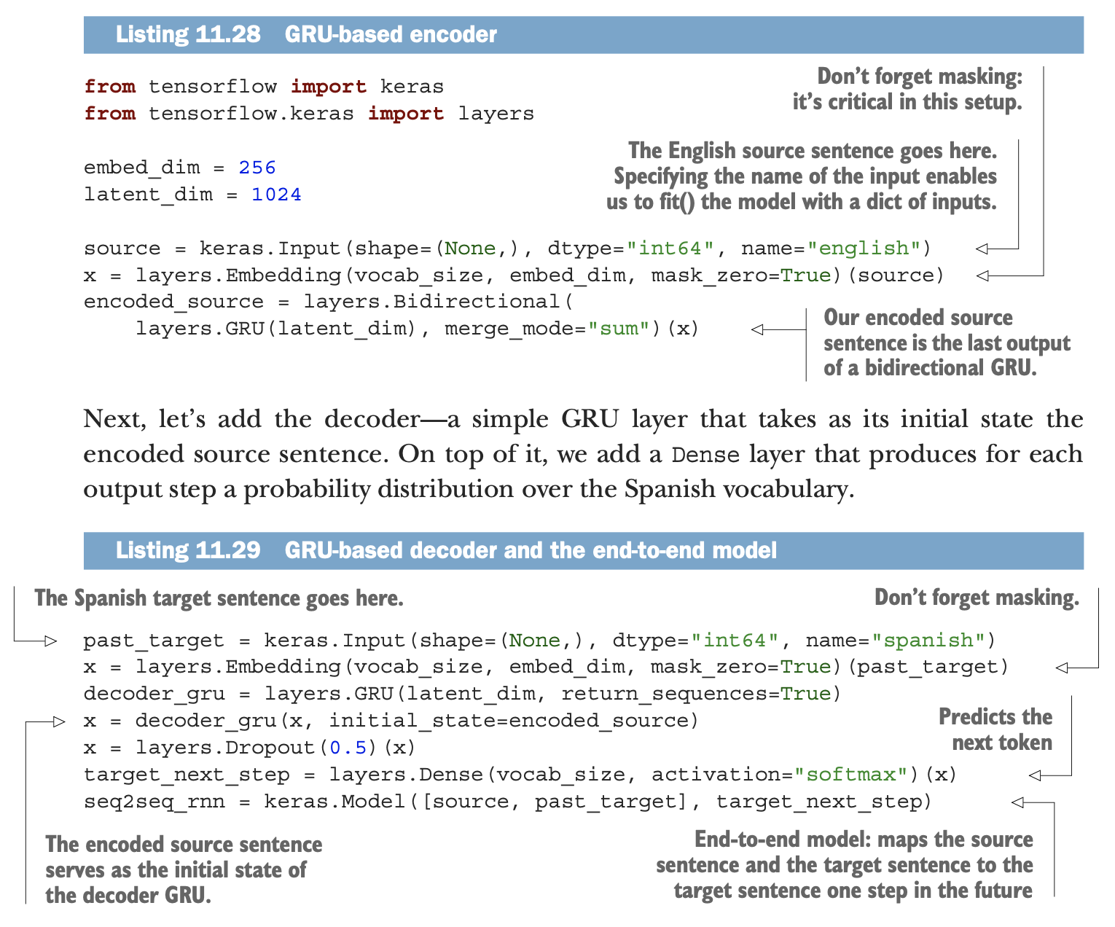
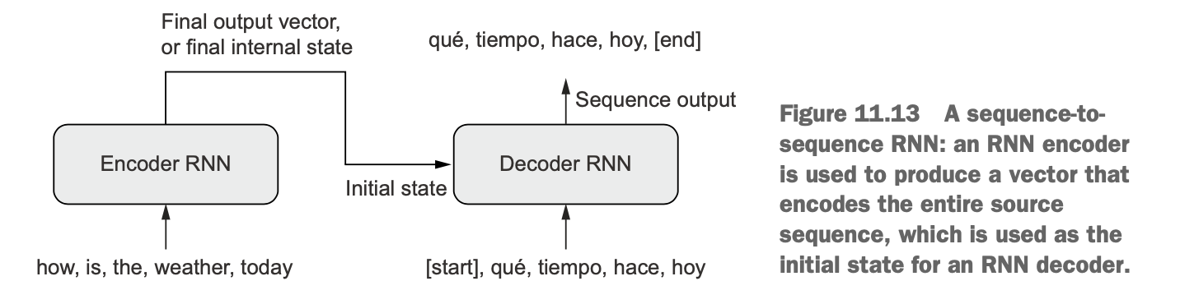
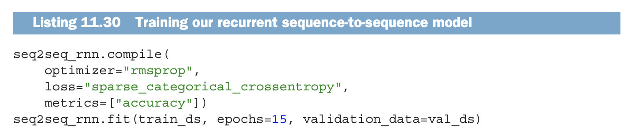
Sequence-to-sequence learning with RNNs
Source sequence →
Word embedding →
Encoder →
Use the last output of a bidirectional GRU as the encoded source
First, use an RNN (the encoder) to turn the entire source sequence into a single vector (or set of vectors)
This single vector could be the last output of RNN or its final internal state vectors
Then you would use this vector (or vectors) as the initial state of another RNN (the decoder), which would look at elements 0…N in the target sequence, and try to predict step N+1 in the target sequence.

Slide 13
Sequence-to-sequence learning with Transformer - 1
a Transformer encoder to process the source sequence
1
machine translation
source
input sequence:
how’s the weather today?
for each element in target (like “tiempo”)
go back to the source and identify the different bits that are related to it
tiempo and weather should have a strong match
keys + values
target
output sequence:
¿Qué tiempo hace hoy?
query
a Transformer decoder that uses the source sequence to generate a translated version
The Transformer encoder: keeps the encoded representation in a sequence format: it’s a sequence of context-aware embedding vectors
The Transformer decoder: it reads tokens 0…N in the target sequence and tries to predict token N+1. While doing this, it uses neural attention to identify which tokens in the encoded source sentence are most closely related to the target token it’s currently trying to predict.

Slide 14
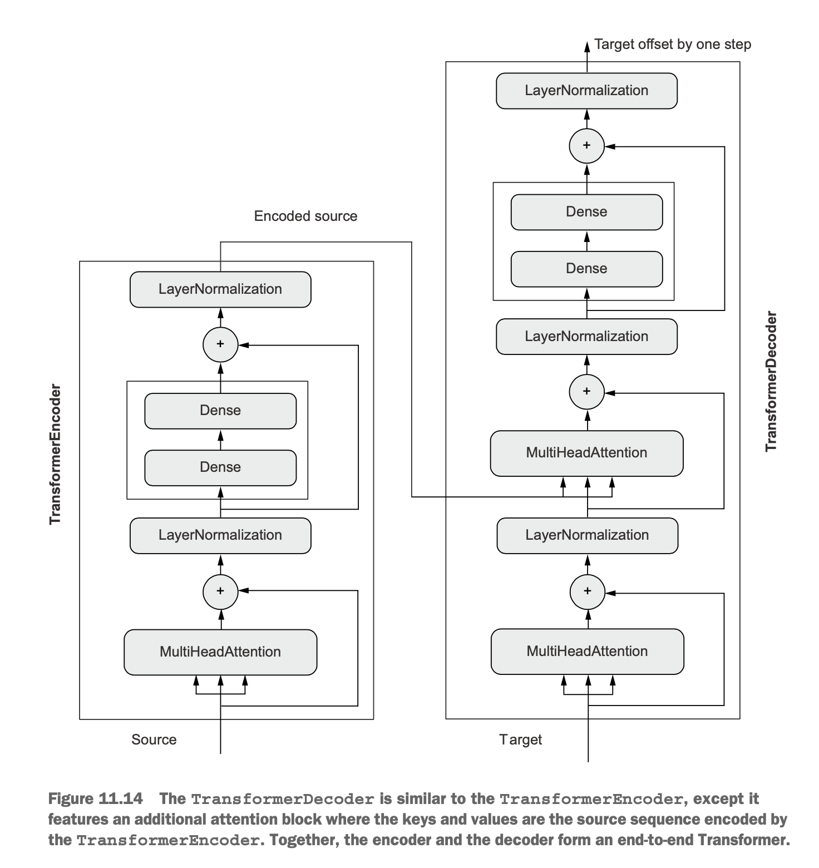
The Transformer architecture

Slide 15
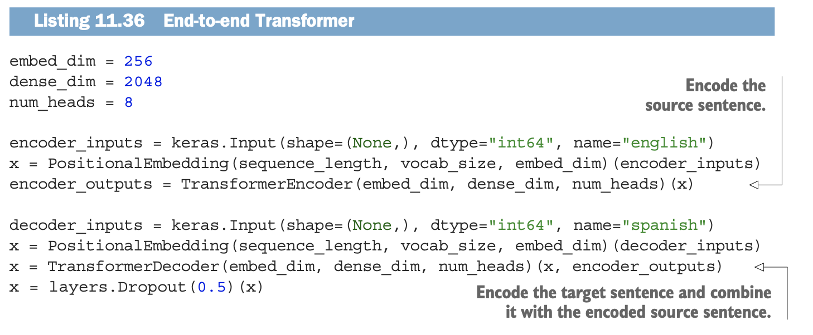
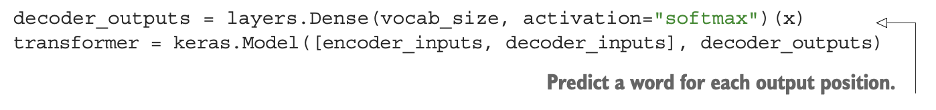
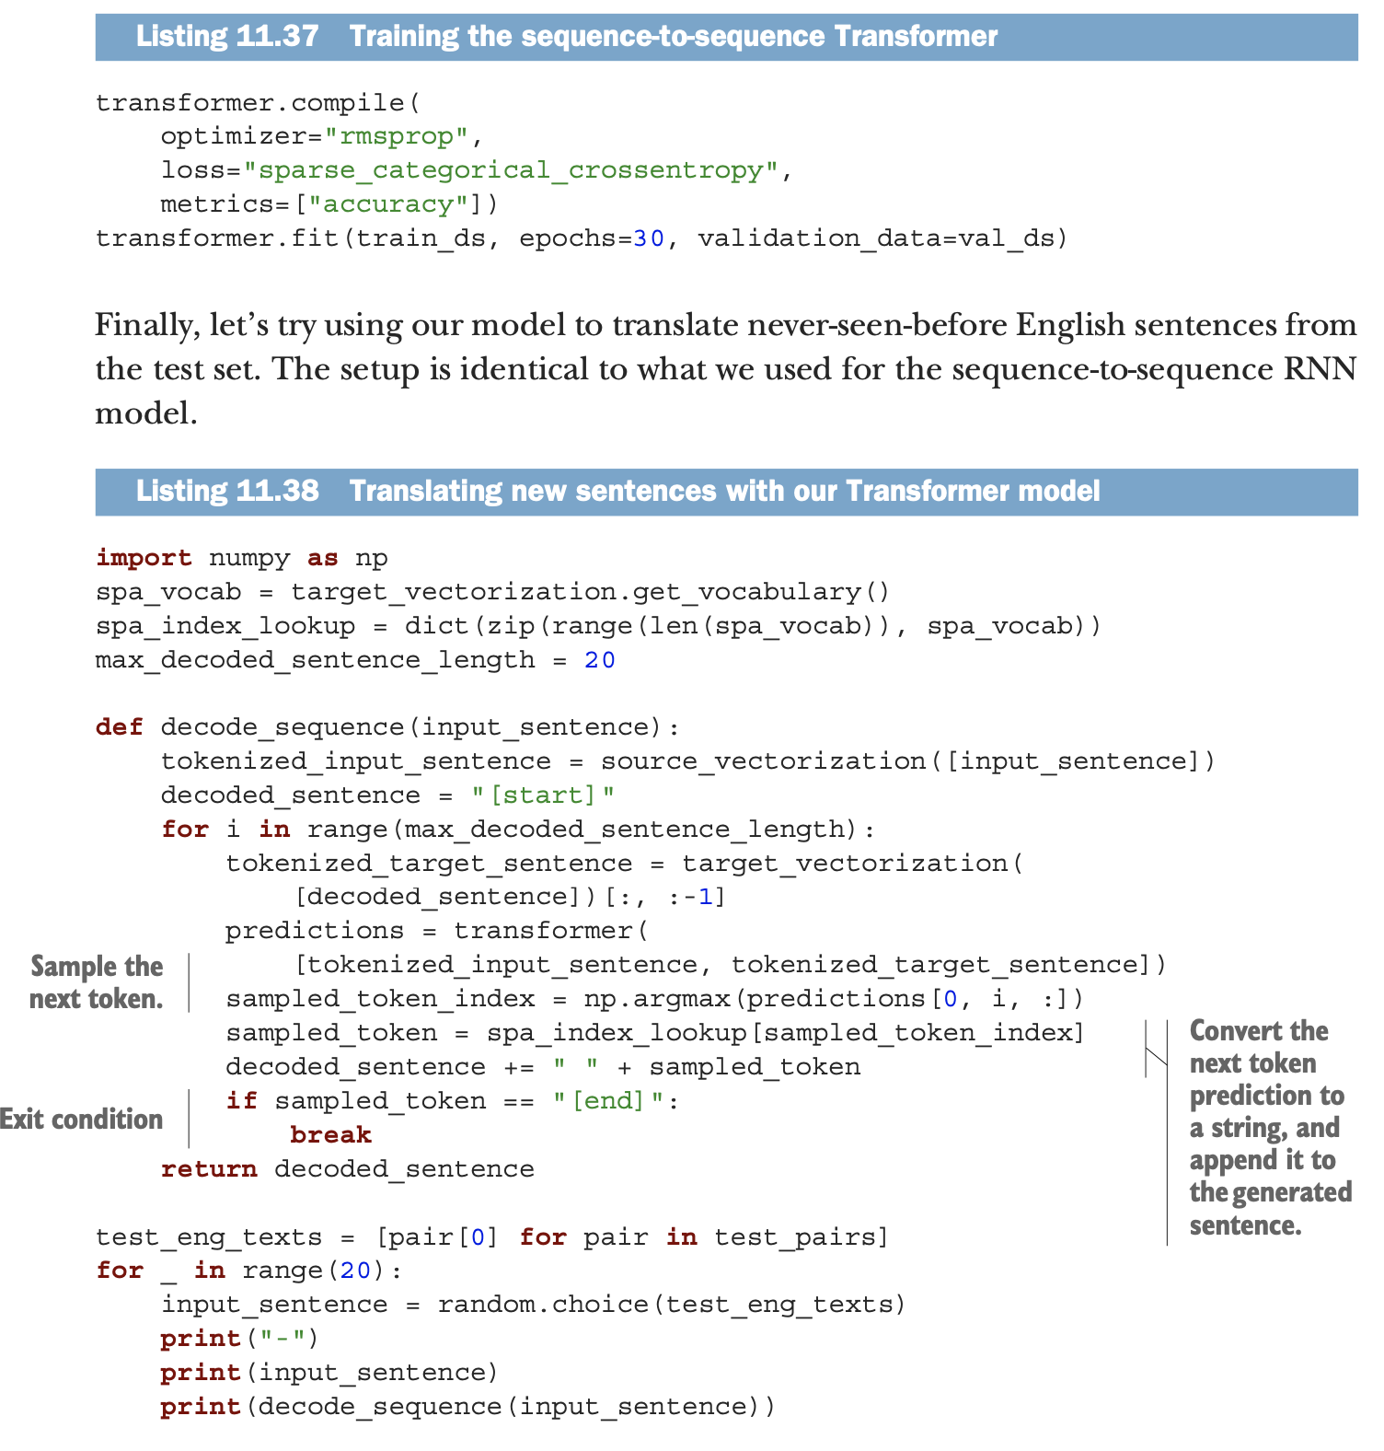
Sequence-to-sequence learning with Transformer - 2

